Slide 1

SRM INSTITUTE OF SCIENCE AND TECHNOLOGY, RAMAPURAM CAMPUS
DEPARTMENT OF COMPUTER SCIENCE AND ENGINEERING
Cryptocurrency price prediction using machine learning techniques
Batch No: B5
PROJECT MEMBERS
S. Balakrishnan– RA1811003020110
J. Vignesh– RA1811003020100
M. Yedu krishnan– RA1811003020075
SUPERVISOR DETAILS
Uma Mageswari
Asst Professor
SRMIST
Department of CSE
1

Slide 2

Objective
Predicting the price of Cryptocurrencies like Bitcoin, Dogecoin.. etc is tough because it does not have any proper fundamentals so its very risky to trade them in the Crypto market.
Since Crypto predictions are unreliable, we need a proper way to predict them to avoid loss while trading in the crypto market.
So, the main objective of our project is to implement machine learning techniques to predict the price of cryptocurrencies in the market.

Slide 3
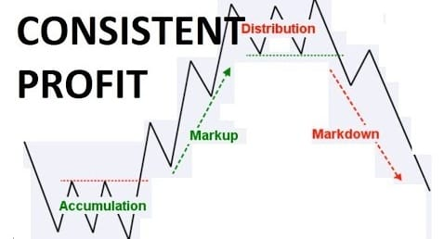
Scope
There are 2 main ways of predicting the cryptocurrency prices in the market one is technical analysis and another one in fundamental analysis.
Main mindset of a successful trader is to make consistent profits in the market.
In our project, we use technical analysis to predict the movement of the graphs in the crypto market by implementing deep learning in them.

Slide 4
Abstract
Like common stocks, cryptocurrency price fluctuations are non-stationary and highly noisy. Since future of money is crypto, cryptocurrency price prediction is attracting a growing attention from both investors and researchers.
Indeed, with the development of machine learning and especially deep learning we predict the price of cryptocurrencies in the market .

Slide 5

Introduction
Cryptocurrencies are a digital way of money in which all transactions are held electronically. It is a soft currency which doesn’t exist in the form of hard notes physically.
Cryptocurrencies become the most favourable and used for commercial enterprise transactions all over the world.
The popularity is due to its innovative characteristics such as transparency, simplicity, and increasing acceptance through the world.

Slide 6
Literature Survey
S.NO | TITLE | AUTHOR | JOURNAL NAME | TECHNOLOGY USED | ADVANTAGES | DISADVANTAGE
1 | Prediction of cryptocurrey returns using machine learning | Erdinc Akyildirim, Ahmet Goncu , Ahmet Sensoy. | IEEE | Machine learning classification algorithms | The best performing and robust models in the prediction of the next day’s return is the support vector machines with consistently above 50% fit and good generalization ability to different sub-periods consistently | Although ,performance of the bit of classification algorithms are not uniform over different coins.
2 | Cryptocurrency Price Prediction Using Tweet Volumes and Sentiment Analysis | Jethin Abraham, Daniel Higdon, John Nelson, Juan Ibarra | IEEE | Blockchain Technology and Cryptocurrencies | Both Google Trends and tweet volume were highly correlated with price | The correlation held during periods of increasing and decreasing prices suggest that the relationship is robust to periods of high variance and non-linearity

Slide 7
S.NO | TITLE | AUTHOR | JOURNAL NAME | TECHNOLOGY USED | ADVANTAGES | DISADVANTAGE
3 | Predicting Fluctuations in Cryptocurrency Transactions Based on User Comments and Replies | Young Bin Kim, jun gi kim,wook kim | IEEE | Crawled all comments and replies posted in online communities | The rich information in online communities can contribute to understanding cryptocurrencies from different perspectives | Time complexity is more.
4 | Short-term bitcoin market prediction via machine learning | Patrick Jaquart, David Dann, Christof Weinhardt | IEEE | Feedforward neural networks (FNN), Long short-term memory (LSTM) and gated recurrent unit (GRU) | The use of multiple random seeds increases stability in the predictions of the stochastic prediction models | RNN and GBC models are particularly well-suited for predicting the short-term bitcoin market
5 | Bitcoin Price Prediction Using Recurrent Neural Networks and LSTM | Ana lucia | IEEE | Recurrent Neural Networks, Long Short-Term Memory (LSTM), | Amount of data is very low and the network architecture is very simple | When it comes to more advanced models with more granular information, it can take hours or days to train

Slide 8
Existing System
In this project they use an algorithm linked to artificial intelligence named LASSO(least absolute shrinkage selection operator) to reduce the time complexity.
The major goal of their project is to predict the accurate values of cryptocurrency with less time complexity as possible.
Many Projects has accurate price but some other don’t, but the time complexity is higher in those predictions. In LASSO, finding of the results from a larger database is quick and fast.
The main aim of their project is to have a clear prediction of Cryptocurrencies with less time complexity or with no delay.

Slide 9
Drawbacks in Existing System
Price predictions of the cryptocurrencies are not that accurate.
Not applicable for all coins.
Not suitable for making consistent profits in the market.

Slide 10
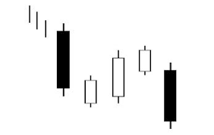
Proposed System
In our project we take 60 days movement of a particular cryptocurrency and predict the next day movement of that in the market.
Example : we take 60 days chart of the bitcoin and predict the movement of it the in present day.
We use machine learning and deep learning in our project to predict the movement of cryptocurrency in the market.
We use many libraries of python like
Data science : NumPy, pandas, matplotlib
To get financial data : Pandas data reader
Machine learning : tenser flow, scikit-learn

Slide 11

Advantages of Proposed System
Price predictions are accurate.
We can predict the prices of all the coins in the market.
We can make consistent profit with this model.
The code has less time complexity and runs without delay.

Slide 12
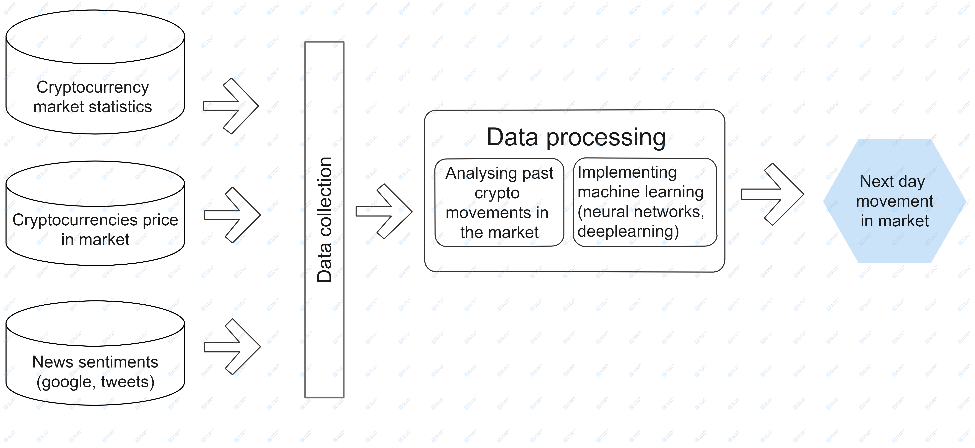
System Architecture

Slide 13
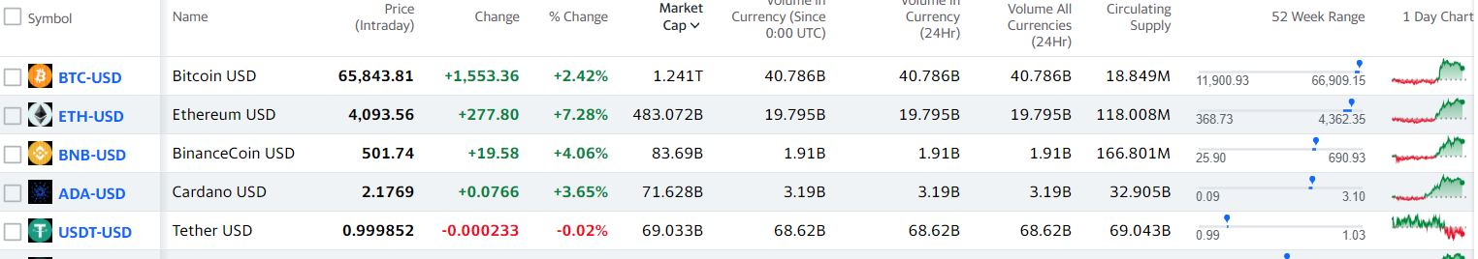
Modules
Importing data :
We use “pandas-datareader” library to import financial data form yahoo finance api.
Yahoo finance is a website which has data of all the markets like crypto, stocks, crude oil…. etc.
We predict the price of the particular crypto currency using it.

Slide 14

Modules
Data pre-processing :
Data preprocessing is a data mining technique which is used to transform the raw data in a useful and efficient format.
So, to avoid wrong predictions of the cryptocurrencies, data has to be analyzed before giving input to the machine learning model.

Slide 15
Modules
Training and Testing :
We split the data into two sets — training set and test set with 80% and 20% data respectively.
we use the training data to fit the model and testing data to test it.
Training and testing set is recorded using “sk learn” python library.
In our project we train 60 days data of the particular coin and predict 61st day using it.
The below commands are used to test the data with actual results.
test_start = dt.datetime(2021, 1, 1)
test_end = dt.datetime.now()
test_data = web.DataReader(f'{crypto_currency}-{against_currency}', 'yahoo', test_start, test_end)

Slide 16
Algorithm- LSTM
It works by using special gates to allow each LSTM layer to take information from both previous layers and the current layer.
The data goes through multiple gates and various activation functions and is passed through the LSTM cells.
The main advantage of this is that it allows each LSTM cell to remember patterns for a certain amount of time.

Slide 17
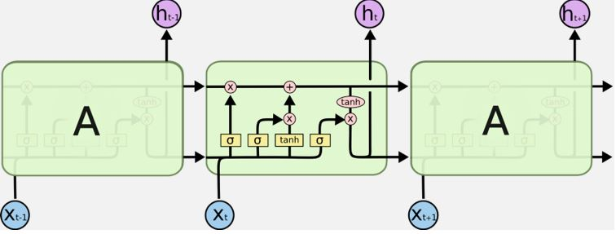
LSTM architecture

Slide 18
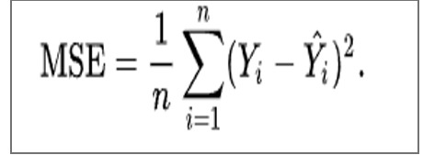
Mean squared error
MSE measures the average of the squares of the errors that is, the average squared difference between the estimated values and the actual value.

Slide 19
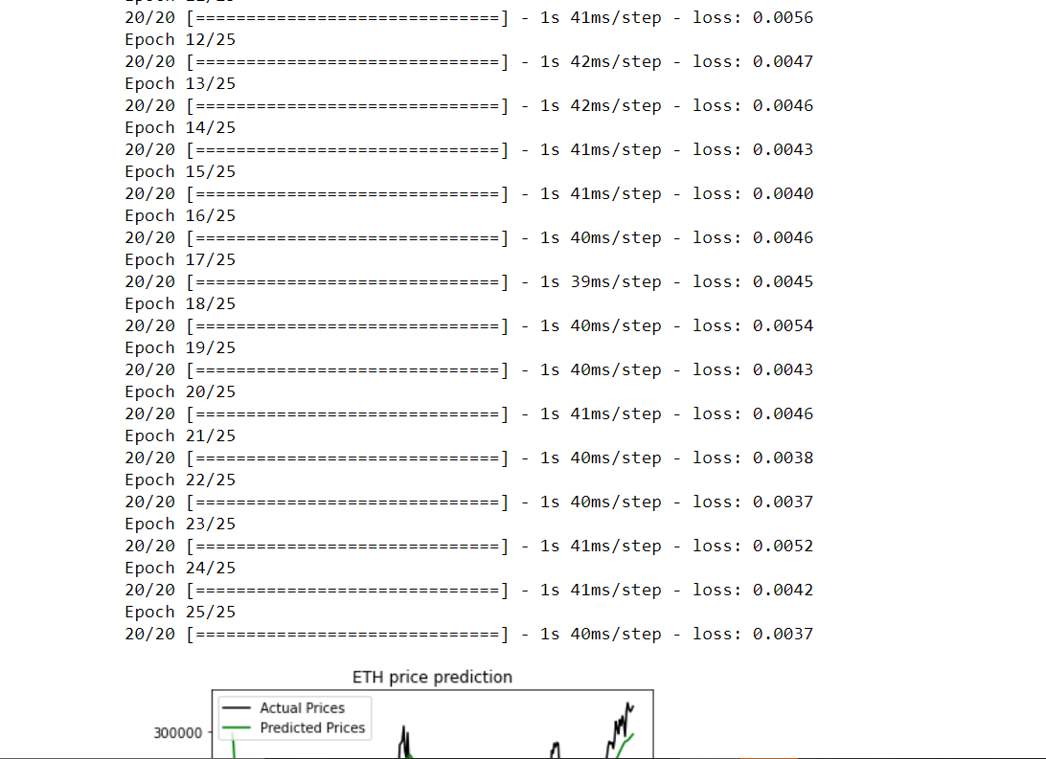
Implementation

Slide 20
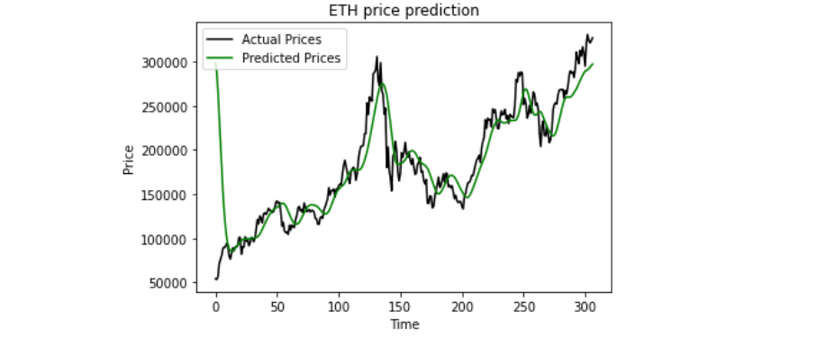

Slide 21
Conclusion
Thus we have tested the correctness of the selected criteria combination on their effect on the price of Bitcoin. For our experiment, we used Multiple Linear Regression, Random Forests, and LSTM ML algorithms implemented with Python in Anaconda Data Science tool.
As a result, we have found that selected combination of criterion can explain more than 70% of cryptocurrency price. On this base, we plan to study additional criteria which affect prices of cryptocurrencies to be able to forecast their prices more accurate.

Slide 22


